Slide 1
Week 3: Creating and populating databases; PostgreSQL

Slide 2
This Week
Week | Lecture Dates (Edgbaston) | Lab Dates (Edgbaston) | Topic
1 | Group 1 - Wednesdays (10:00-12:00) Group 2 - Fridays (12:00-14:00) | Fridays (14:00-17:00) | Introduction to databases; Database design guidelines
2 |  |  | Database design, Entity relation (ER) modelling; Keys; Normalisation​
3
3 |  |  | Creating and populating databases; PostgreSQL
4 |  |  | SQL Querying – Operators, Ordering, Aggregation; NoSQL and Graph Databases
5 |  |  | Class Test
6 |  |  | NoSQL and Graph Databases; Assessment support week
7 |  |  | Web programming introduction; Tech stack, Template application
8 |  |  | Web applications vs Static pages; Tech stack concepts; REST APIs; RESTFUL style
9 |  |  | SpringBoot application structure,; SpringBoot annotations, case study
10 |  |  | Front end concepts, TypeScript fundamentals, Angular front end development,
11 |  |  | Class Test

Slide 3
Last Week
ER Diagram
Organised data for easy access and management
Main Components
Entities, Attributes, Relationships
ER Tools JDL

Slide 4
Today’s Topic: PostgreSQL
Introduction PostgreSQL
Installing PostgreSQL
Creating a Database and Tables
Basic SQL commands
Summary

Slide 5


Preliminaries
These lectures will be focused on PostgreSQL and, more importantly, the psql command line tool.
The skills are transferable to other Database Management Systems as well as other front ends to PostgreSQL.
Note also that we will not be covering ALL possible commands that exist in psql and SQL (Structured Query Language).
It is up to the student to explore additional commands as necessary.

Slide 6
Introduction
PostgreSQL is an advanced, free, and open-source relational database management system (DBMS).
PostgreSQL supports both SQL (relational queries) and JSON (non-relational data) for flexible data management.
It is known for being reliable, robust, and actively maintained for over 20 years by a large developer community.
Commonly used for web applications, data analytics, and enterprise solutions

Slide 7
Core Features
Highly Extensible: Supports custom data types, functions, and procedural languages.
Strong Data Integrity: Implements constraints, transactions, and ACID compliance for secure, accurate data.
Multi-platform Support: Runs on Windows, Linux, and macOS.
Key Operations: Creating databases and tables, inserting and retrieving data, updating and deleting records.
Widely adopted by organizations like Apple, Cisco, and Instagram.

Slide 8
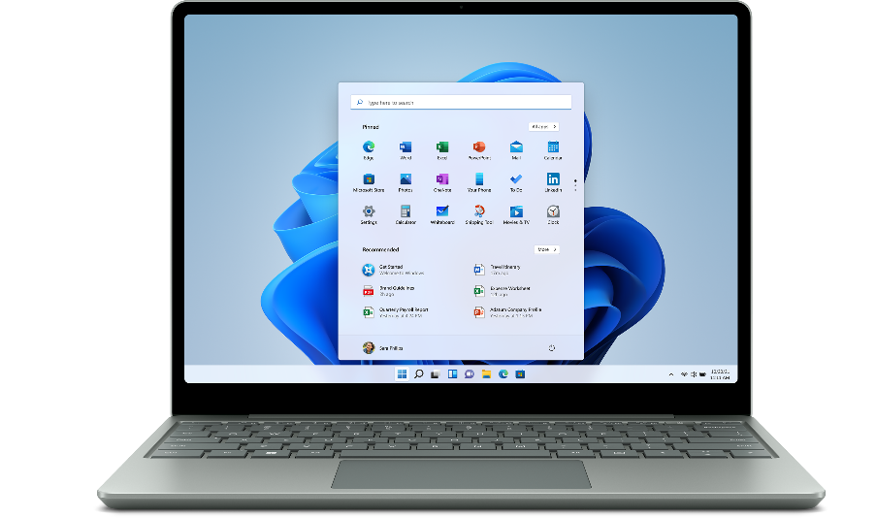
Installing PostgreSQL
Personal Devices
install “PostgreSQL” by visiting the link.
https://www.postgresql.org/download/
PostgreSQL version 14.7 or older
(some queries will not run properly on latest version 15.2)
Don’t forget the Admin password.

Slide 9
Installing PostgreSQL
Please check Canvas for Video Tutorials on installing PostgreSQL
From this point onward we are assuming that the PostgreSQL DBMS (Database Management Server) is installed on the machine you are working on.
We will be using a combination of psql and SQL commands in this class.
Please note that the psql commands will only work the PostgreSQL, while the SQL commands should work with any DBMS.

Slide 10
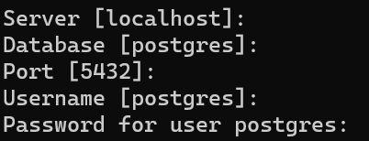
Database server
Access local database server
Open the program “psql” and/or “pgAdmin 4”
default password for local postgres instance on Dubai lab cluster machine is “postgresql”.
Access Edgbaston database server
Create your CS account by visiting this link: https://my-account.cs.bham.ac.uk/
Remote hostname: postgres-teaching.services.aws.cs.bham.ac.uk
Username: your University (ADF) username
Password: your CS account password

Slide 11
Superusers
Warning:
When installing PostgreSQL a Superuser account should have been created. This account has full access to all the server features, which can be a security risk. For this reason we are going to setup a user that we can use for a specific Database.

Slide 12
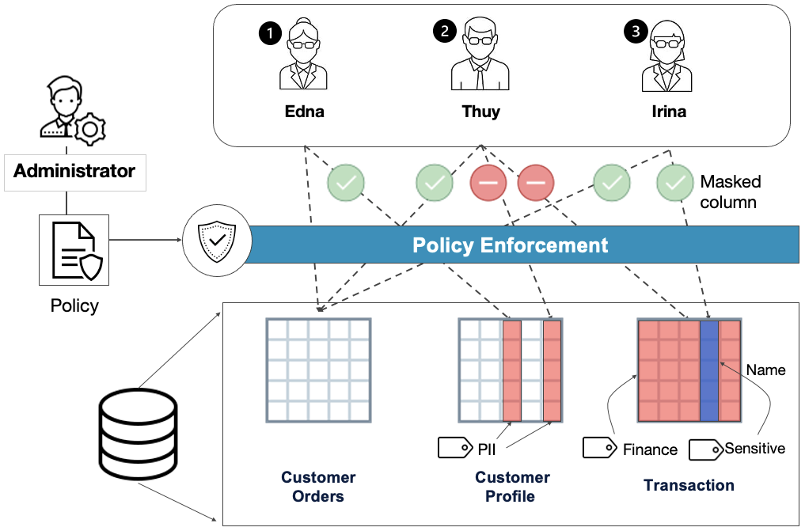
Importance of database access control

Slide 13
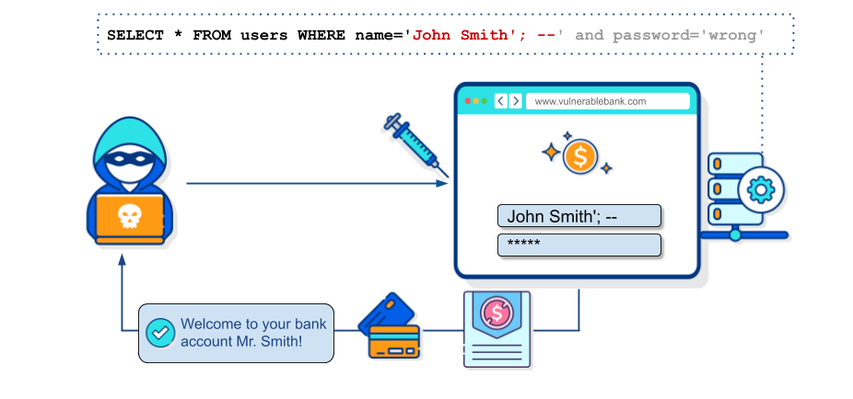
SQL injection attack
https://owasp.org/www-community/attacks/SQL_Injection

Slide 14
Using psql
To be able to add a new user (and perform all the commands we want to on the database), we need to use the psql commandline tool.
Open up your commandline or shell tool (Windows: cmd or Powershell, Mac: Terminal, Linux: any installed terminal tool)
Type in the following command to open psql with the postgres database:
01 | psql postgres

Slide 15
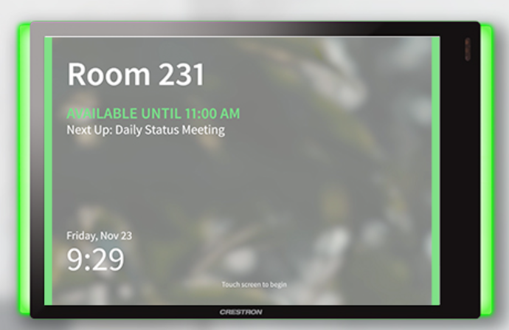
Example 1: Room Booking Service

Slide 16

Example 1: Room Booking Service
CS staff
Room
room_id | room_name | room_capacity | room_zoom
G0210 | Seminar Room | 50 | yes
E1236 | Lab | 40 | no
G0205 | auditorium | 100 | Yes
… | … | … | …

Slide 17
Example 1: Room Booking Service
Room
CS staff
room_id | room_name | room_capacity | room_zoom
G0210 | Seminar Room | 50 | yes
E1236 | Lab | 40 | no
G0205 | auditorium | 100 | Yes
… | … | … | …
text
text
integer
text

Slide 18
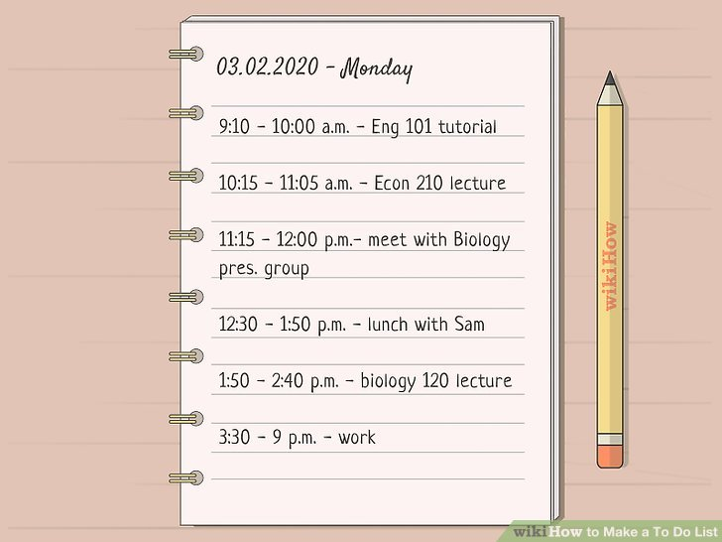
Example 2: To do list App
testuser

Slide 19
Example 2: To do list App
testuser
todo_item
todo_item_id | description | owner_id | priority_id | context_id | status_id | project_id | due_date | completion_date
integer
text
integer
integer
integer
integer
integer
date
date

Slide 20
Setting up users for PostgreSQL
Creating a new user named testuser with a password password. Note the use of single quotes for string literals:
| CREATE ROLE cs_staff
| NOINHERIT LOGIN PASSWORD 'password';
| CREATE ROLE testuser
| NOINHERIT LOGIN PASSWORD 'password';
Viewing all the users in a database:
01 | \ du
Notice how our new testuser has no attributes (i.e. permissions associated with it)

Slide 21
psql vs SQL
Syntax
Note the difference in syntax between SQL commands and psql instructions.
SQL commands end in a semi-colon, while psql commands start with a backslash.
Reserved words in SQL (e.g. CREATE, SELECT etc.) are generally written in all upper case to make them easier to read.
Most DBMSes are not case sensitive but it is always good practise to make sure your case keeps matching.

Slide 22
Outline (This Week)
PostgreSQL
Creating a Database and Tables
Basic SQL commands

Slide 23
Creating a Database (Example 1)
We cannot grant database specific permissions to our new user if we don’t have a database that we want them to use.
We first need to create a data base as follows:
01 | CREATE DATABASE room_booking
02 | WITH
03 | OWNER = cs_staff
04 | ENCODING = 'UTF8'
05 | CONNECTION LIMIT = -1;
We can now connect to our new database with our new user as follows:
01 | \ c room_booking cs_staff

Slide 24
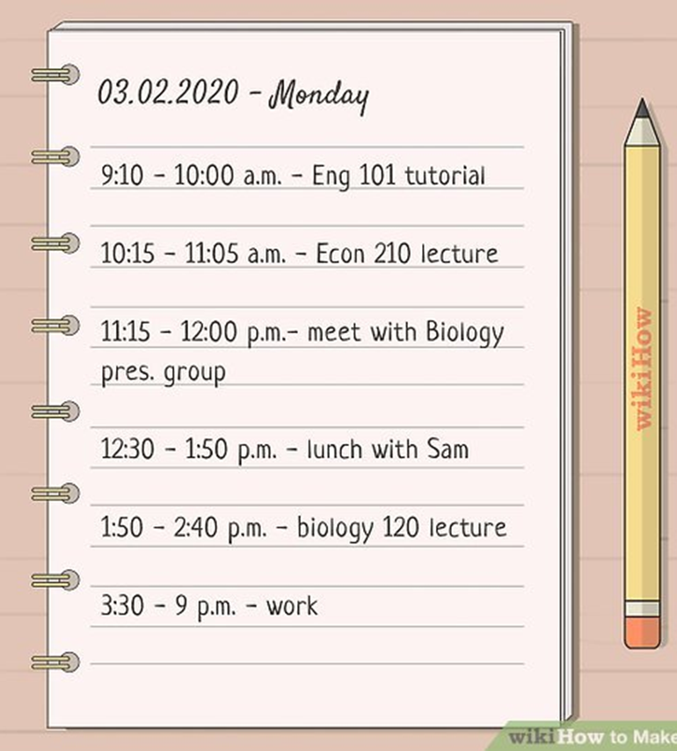
Creating a Database (Example 2)
We cannot grant database specific permissions to our new user if we don’t have a database that we want them to use.
We first need to create a data base as follows:
01 | CREATE DATABASE todo_list
02 | WITH
03 | OWNER = testuser
04 | ENCODING = 'UTF8'
05 | CONNECTION LIMIT = -1;
We can now connect to our new database with our new user as follows:
01 | \ c todo_list testuser

Slide 25
Creating a Table (Example 1)
To create a table we use the SQL command shown below. We’ll discuss this command in more detail in the next couple of slides:
CREATE TABLE public.room
(
room_id text NOT NULL,
room_name text,
room_capacity integer,
room_zoom text,
PRIMARY KEY (room_id)
);
Room
room_id | room_name | room_capacity | room_zoom
G0210 | Seminar Room | 50 | yes
E1236 | Lab | 40 | no
G0205 | auditorium | 100 | Yes
… | … | … | …
In case of permission denied error,
GRANT CREATE ON SCHEMA public TO cs_staff;
integer
text
text
text
Notes:
only works in PostgreSQL 14 and below
GRANT CREATE ON SCHEMA public TO testuser;

Slide 26
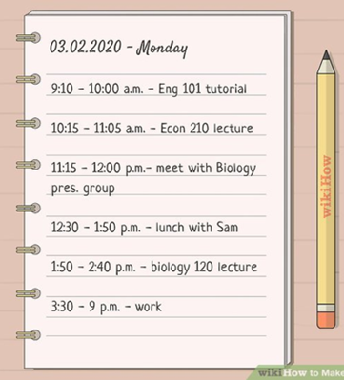
Creating a Table (Example 2)
To create a table we use the SQL command shown below. We’ll discuss this command in more detail in the next couple of slides:
CREATE TABLE public.todo_item
(
todo_item_id integer NOT NULL,
description text,
owner_id integer,
priority_id integer,
context_id integer,
status_id integer,
project_id integer,
due_date date,
completion_date date,
PRIMARY KEY (todo_item_id)
);
todo_item
todo_item_id | description | owner_id | priority_id | context_id | status_id | project_id | due_date | completion_date
integer
text
integer
integer
integer
integer
integer
date
date
Notes:
only works in PostgreSQL 14 and below
GRANT CREATE ON SCHEMA public TO testuser;

Slide 27
Schemas
In PostgreSQL we can organise tables within a Database according to schemas.
A schema allows us more control over access to a Database.
For example we can have a schema setup for management and another for employees.
The management schema could include more tables (e.g. payroll information), while the employee scheme would be limited to tables the employees need for daily work only (e.g. sales information).
In our example we are going to be using the default public schema, that includes all tables in a database, and is created automatically when we create a database.
Notes:
Schemas

Slide 28
Table Columns
Each table we create needs to define columns that store the various attributes of one row in our table.
For example, we need to define what attributes (e.g. description, due date etc.) we need to store per todo item in our table.
Each column definition includes the name of the column, the datatype, and a number of other optional parameters
The names of the column follow a similar set of rules to naming variables in a language like Java, e.g. no spaces, no special characters, cannot start with a number etc.
Notes:
Table Columns

Slide 29
Setting up user permissions
Because we made testuser the owner of todo_list, testuser can do almost everything we want with the todo_list database.
We can GRANT and REVOKE more fine-grained permissions using code similar to the examples below (assuming a table named todo_item exists):
| REVOKE SELECT ON public. todo_item FROM testuser;
| GRANT SELECT ON public. todo_item TO testuser;
Notes:
Setting up user permissions

Slide 30
Data Types
Each column we add to a Table needs to have a Datatype.
In the same way we declare variables in Java as String, int etc. we need to define data types for the columns in our Tables.
The example above has the integer, text and date datatypes.
There are many more datatypes available in PostgreSQL so please take some time to research what they are and when they should be used.
Notes:
Data types

Slide 31
Defining Constraints
In any database we need to define various relationships and constraints.
One of the main constraints we will define is the PRIMARY KEY constraint.
In the example about we set the todo item id as the PRIMARY KEY for that table.
we also define that the todo item id cannot be null, using the NOT NULL optional definition.
We need both of these definitions in place to ensure that our PRIMARY KEY constraint will work correctly.
Notes:
Defining constraints

Slide 32
Foreign Keys
The todo item table mostly contains ids that will link to primary keys in other tables that we will still create.
This means for the moment our data will mostly be a bunch of ids but we will look at ways to link everything together in the upcoming weeks.

Slide 33
Outline (This Week)
PostgreSQL
Creating a Database and Tables
Basic SQL commands

Slide 34
CRUD
The basic actions we can perform on a table are Creating new data, Reading existing data, Updating (or Editing) existing data and, Deleting existing data.
These actions are known by the acronym CRUD (Create, Read, Update, Delete)
In SQL these actions are performed by the INSERT, SELECT, UPDATE and DELETE commands.

Slide 35
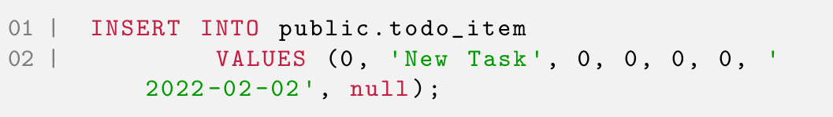
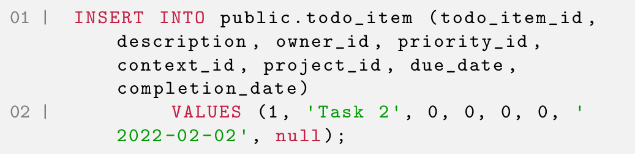
INSERT into a table
To insert into a Table we need to specify the values that we want to insert as a comma separated list in the same order that the columns are organised in the table:
We can also explicitly specify the column order to insert into:
Notes:
INSERT into a table

Slide 36
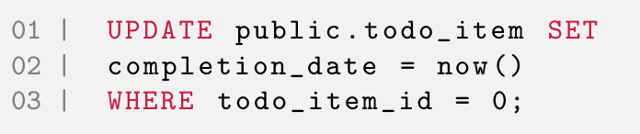
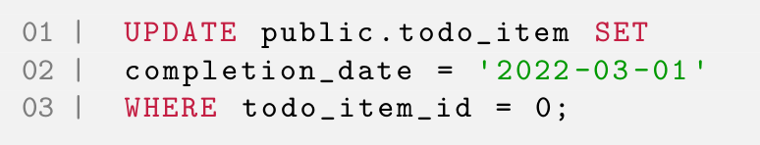
UPDATE exiting data
To update data in a table, we need to define the table in which we want to make the update, the column(s) that we want to update, the new value we want use, and finally, where in the table we want to make the update(s).
In this example we are using a built-in SQL function named now that returns the current date, but we could update a column to any valid value:
Notes:
UPDATE existing data

Slide 37
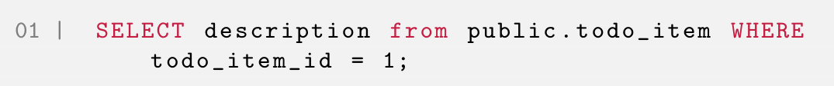
SELECT from a table
When we want to read data from a Table we use the SELECT command:
In this example we are selecting all the columns and rows in a table. To select a specific column we use:
Finally to specify a specific row (or rows) we use a WHERE clause:
Notes:
SELECT from a table

Slide 38
DELETE from a table
If we want to delete data from a table we use the DELETE command:
We don’t need to specify a column as we can only delete an entire row.
We’ve also define a specific WHERE clause that deletes all items whose complete dates are older than a specified date.
Notes:
DELETE from a table

Slide 39
DELETING
Warning
Please note that you need to specify a WHERE clause when deleting or else the DELETE command will delete all the rows in a table.

Slide 40
WHERE clause
Note
We’ve been using the WHERE clause to specify a specific column (or columns) in various ways.
There are many more permutations we can use to have fine-grained control over exactly which rows we want to specify.
We will be looking at these in more detail in the next two weeks, but please feel free to do some research regarding the WHERE clause so long.

Slide 41
Saving you SQL
It might be a good idea to save the sql scripts you run in a text file.
If a script runs successfully, copy and paste it into a file and save it so that you can re-use it later.
We will look at running sql scripts from a file in a later lecture.

Slide 42

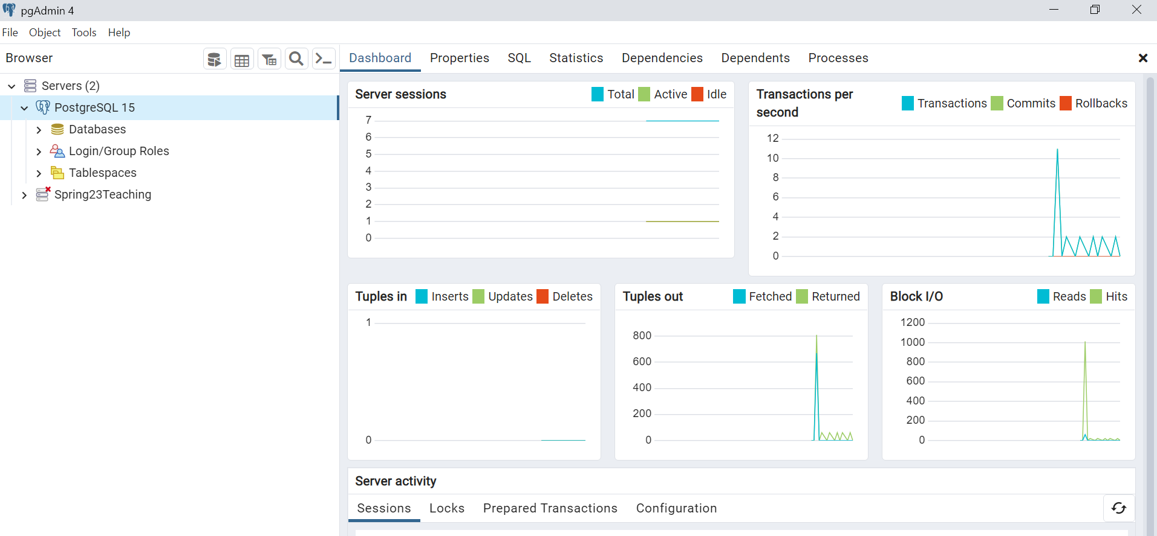

Slide 43
Summary
PostgreSQL
Creating a Database and Tables
Basic SQL commands

Slide 44
Next Week
Week | Lecture Dates (Edgbaston) | Lab Dates (Edgbaston) | Topic
1 | Group 1 - Wednesdays (10:00-12:00) Group 2 - Fridays (12:00-14:00) | Fridays (14:00-17:00) | Introduction to databases; Database design guidelines
2 |  |  | Database design, Entity relation (ER) modelling; Keys; Normalisation​
3
3 |  |  | Creating and populating databases; PostgreSQL
4 |  |  | SQL Querying – Operators, Ordering, Aggregation; NoSQL and Graph Databases
5 |  |  | Class Test
6 |  |  | NoSQL and Graph Databases; Assessment support week
7 |  |  | Web programming introduction; Tech stack, Template application
8 |  |  | Web applications vs Static pages; Tech stack concepts; REST APIs; RESTFUL style
9 |  |  | SpringBoot application structure,; SpringBoot annotations, case study
10 |  |  | Front end concepts, TypeScript fundamentals, Angular front end development,
11 |  |  | Class Test

Slide 45
Questions?

Slide 46
References
Ramakrishnan, R., Gehrke, J. and Gehrke, J., 2003. Database management systems (Vol. 3). New York: McGraw-Hill.Rochester
PostgreSQL Tutorial – https://www.postgresqltutorial.com Clear and structured introduction covering installation, SQL basics, and advanced features.
Postgres Professional Blog – https://postgrespro.com/blog Articles on advanced PostgreSQL features, performance, and administration.

